Slide 1

PhD in Nanoscience and Advanced Technologies
Winter School of Microscopical Sciences
Part 1-November 2017
Part 2- November 2018
Light microscopy:
bright field, phase contrast and DIC microscopy
(Dr. Vittorio Bertone, PhD - University of Pavia)

Slide 2
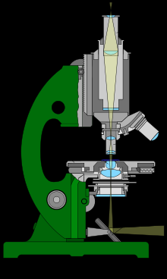
The microscope…
...this unknown…
The most common tool for the biologist, but also one of the most neglected…
Ancient tool. But not old !

Slide 3
The optical microscope is a tool that enhance our visual abilities in the microscopic world.
It doesn’t enlarge microscopic objects, but give us enlarged images of them.
Images producted from the microscope has also an important feature: they have a good resolution, better than that of our eyes.

Slide 4
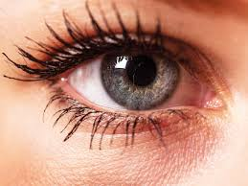
With our eyes…
Perception threshold
Minimum dimensions of the
object to be perceived by
our eyes
Resolution threshold
Minimum distance between two
points for distinguishing them as
separate
»
Perception threshold
0.004 mm
(4 µm)
Resolution threshold
0.1 mm
(100 µm)

Slide 5
Resolution of eyes…
(100 µm)
0.1 mm
If closer than 0.1 mm

Slide 6
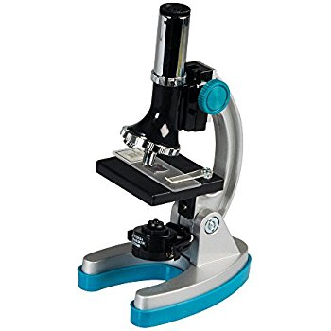
With the microscope we can improve the resolution threshold until
0.0002 mm
(200nm or 0.2 μm)
Images produced by the microscope allow us to see the finer details of the objects, not only an enlarged image of them

Slide 7
Human eye →
Optical microscope →
SEM →
TEM →
RESOLUTION & BIOLOGY
Resolution
1 mm
0.1 mm = 100 µm
10 µm
1 µm
0.2 µm = 200 nm
100 nm
10 nm
1 nm
1 Å
Epithelial cells
Red blood cells
Bacteria
← mitochondria
Virus
Proteins
Aminoacids
Atoms

Slide 8
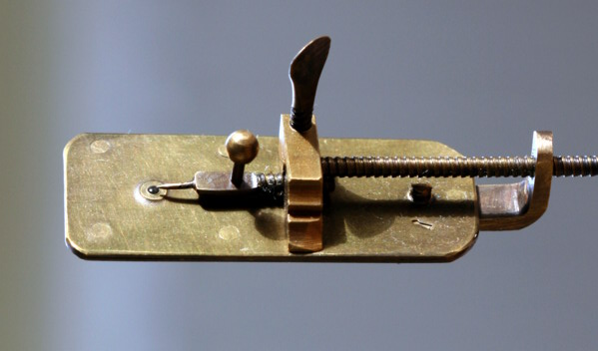
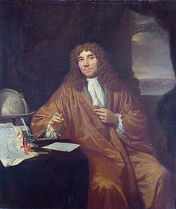
Single lens microscope
Focusing system
Centering system
Needle for specimen
Single lens
Microscope of Anton van Leeuwenhoek
(Delft, 24 october 1632 – Delft, 27 august 1723), was a dutch optician and naturalist.
Pronuncia: http://it.forvo.com/word/anton_van_leeuwenhoek/
http://translate.google.it/?hl=en&tab=wT#auto/en/anton%20van%20leeuwenhoek

Slide 9
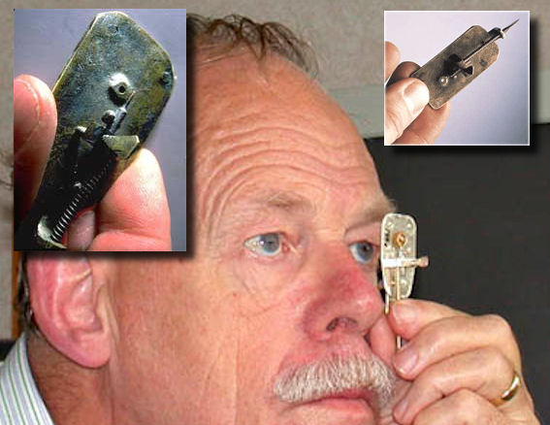
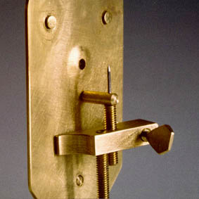

Slide 10
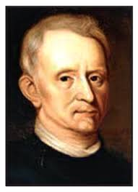
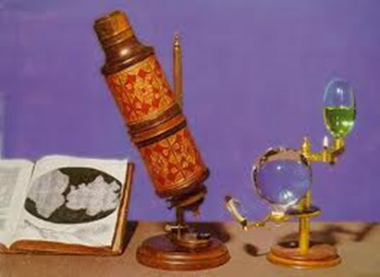
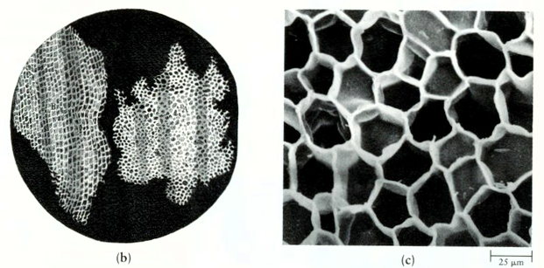
In 1678 Robert Hooke perfected the microscope, developing a Compound Microscope with two lenses (objective and eyepiece), an oil lamp as light source, a mirror and a fishbowl full of water as condenser)
He gave the definition of “cell” to the elementary structures of the cork

Slide 11
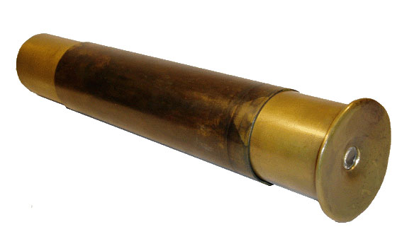
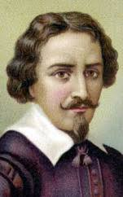
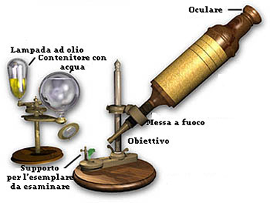
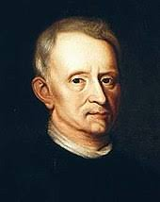
At the beginning....
Zacharias Janssen
1590
Robert Hooke
1665

Slide 12
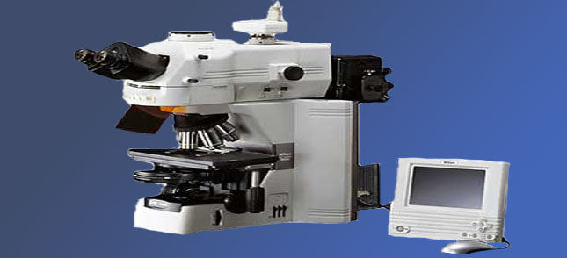
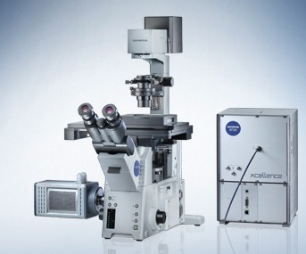
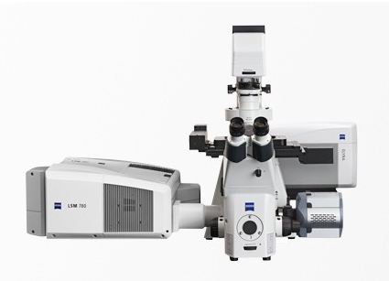
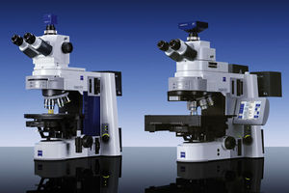
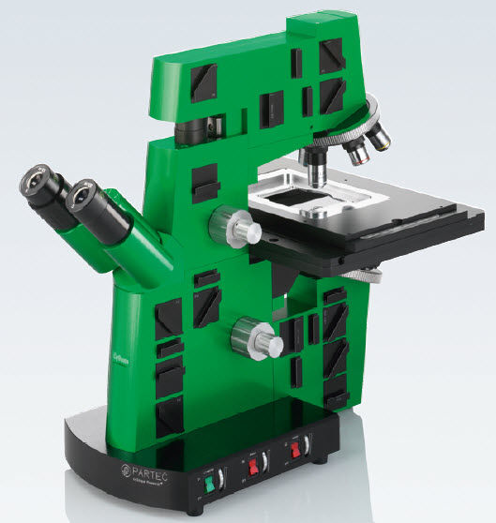
…today ….

Slide 13
THE MICROSCOPE
- It produces enlarged and resolved images of small objects
It allows direct observation, or indirect through photography and/or electronic systems
OPTIC - In Brightfield
- In Phase Contrast
- In Differential Interference Contrast (DIC)
- Confocal
- Atomic Force
- Two-photon. . . . etc..
ELECTRONIC
        Transmission (TEM) - based on the observation by electron beam that pass through the specimen
        Scan (SEM) – based on the exploration of the specimen surface

Slide 14
The Optical Microscope has 2 essential features.
He is able
to magnify - The magnification of an object at 25 cm (accommodation
distance of eyes) is considered 1x.
- The microscope offers higher magnifications, until 1000x
b) to resolve - until 0.0002 mm
To form images he use the same light that normally illuminates object, in particular the portion of the electromagnetic radiation of wavelength (λ) between 400 and 700 nm

Slide 15
An enlarged image without fine details is unuseful, so:
to evaluate the quality of a microscope, it makes no sense to consider only its maximum magnification, but also its maximum resolving power !!!

Slide 16
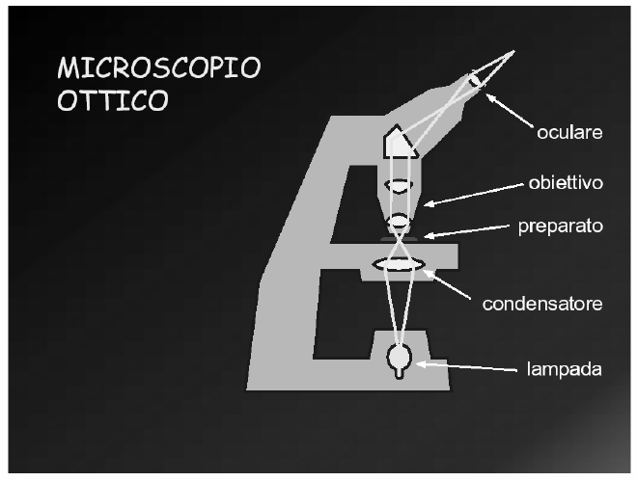
MICROSCOPE
STRUCTURE

Slide 17
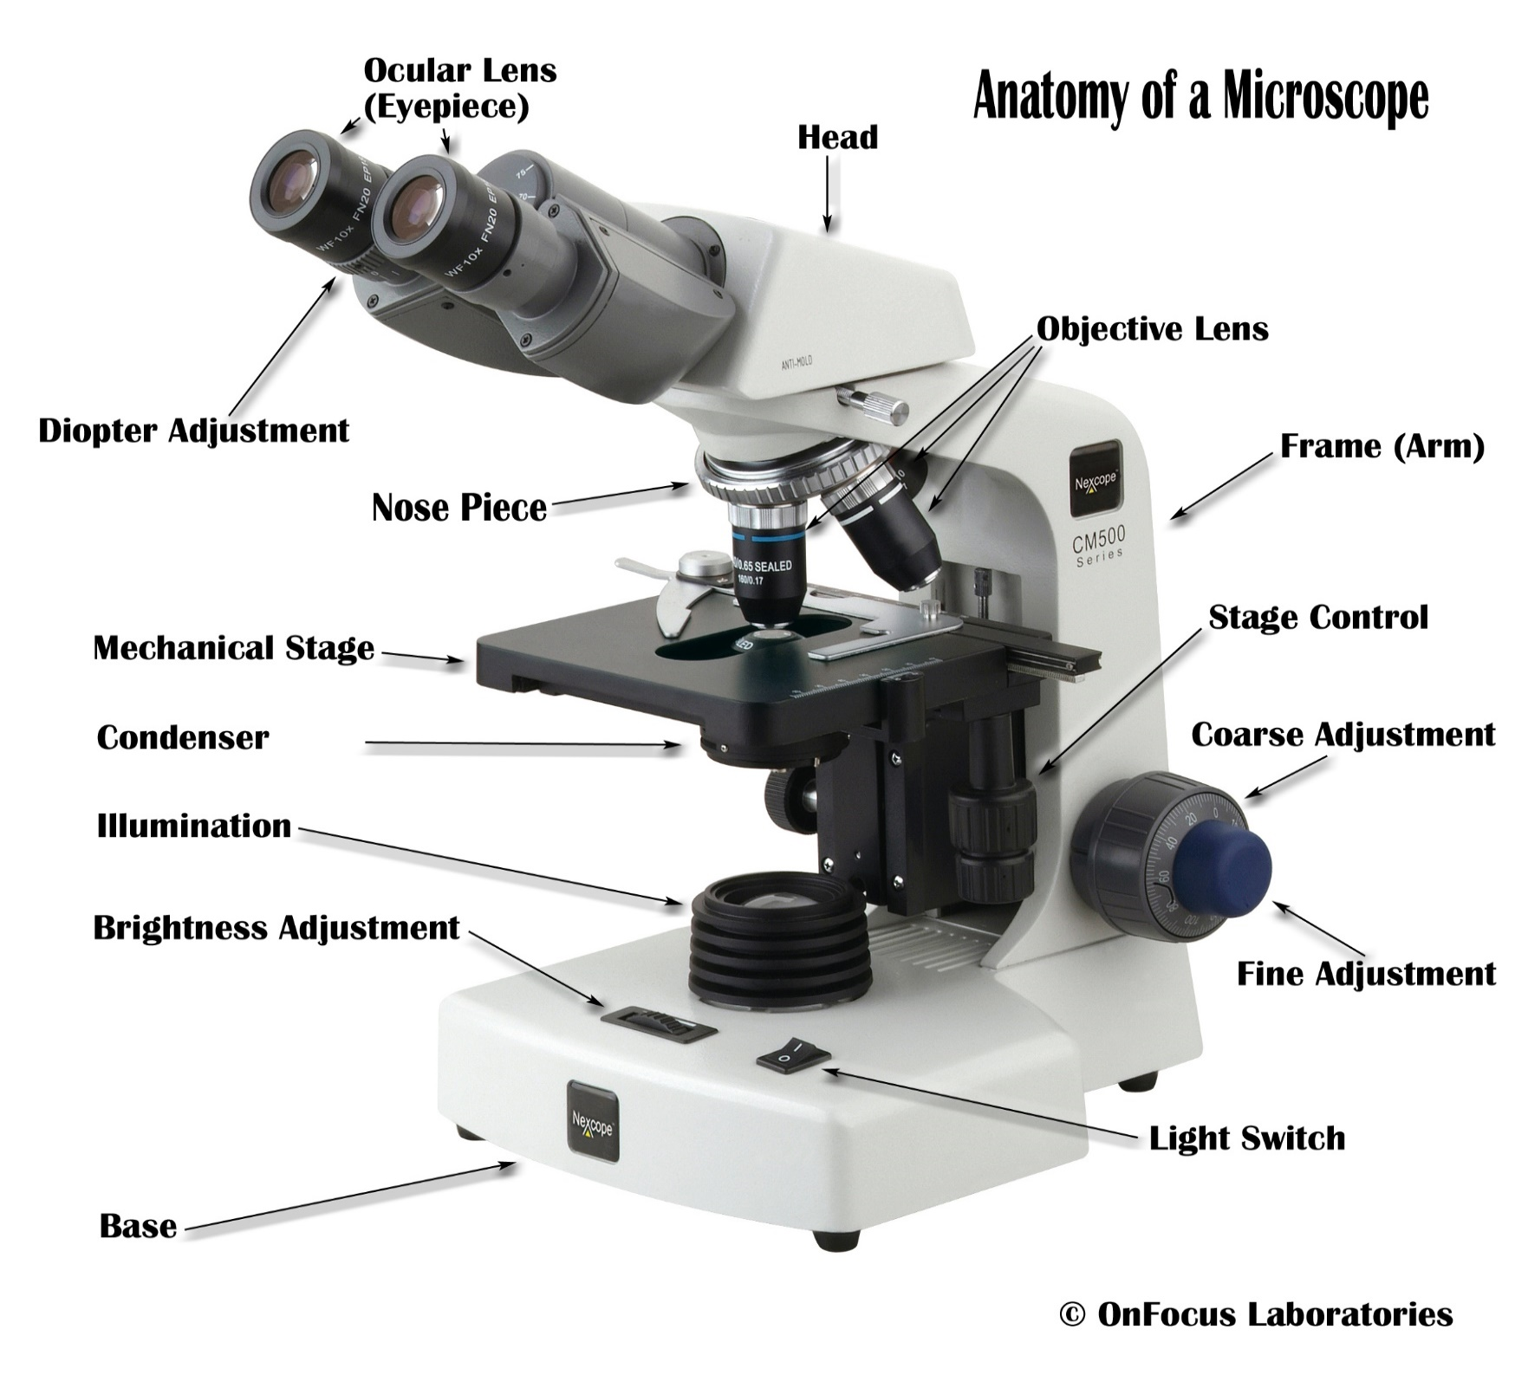
Standard compound microscope

Slide 18
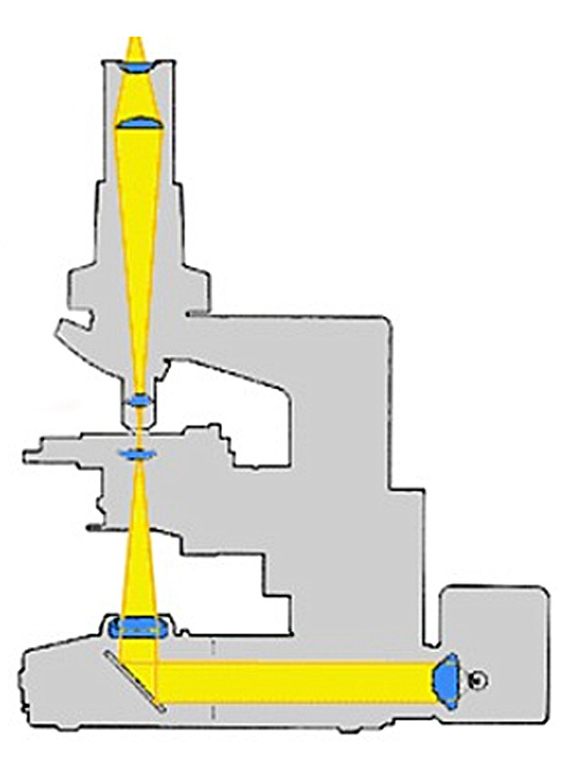
Standard compound microscope scheme
Ocular (eyepiece)
Objective
specimen
Condenser (with diaphragm)
Aperture Diaphragm
Field diaphragm
Light source

Slide 19
The optical microscope is constituted by the following functional parts:
- STAND
It is the backbone of the microscope that supports or incorporates optical and mechanical parts. In modern microscopes, has the appearance of an arch-shaped metal C.
- ILLUMINATOR WITH LIGHT SOURCE
The light source often used is a "traditional“ tungsten lamp. This light source emits waves of different wavelength. The total range of wavelengths is the light spectrum of the source.
The spectrum could be a continuous spectrum, but if it lacks some wavelengths is defined band spectrum.
TODAY: developing LED (Light Emitting Diode) as light source, more durable

Slide 20
- CONDENSER
Lens that focuses the light on the specimen, to make it brighter and better observable. It has a diaphragm (Aperture Diaphragm), it can be moved up and down and centered
- OBJECT STAGE
Support for the specimen. It has x-y movements, in order to bring the particular interest to the center of the visual field.
- FOCUSING MOVEMENTS
A device that allows you to vary the distance between lens and object stage, in order to have a clear image ("Focused"). It is sometimes distinguished in a mechanism of approach, with a wide stroke but not very sensitive (macrometric), and a finest mechanism with short stroke but more gradual (micrometric).

Slide 21
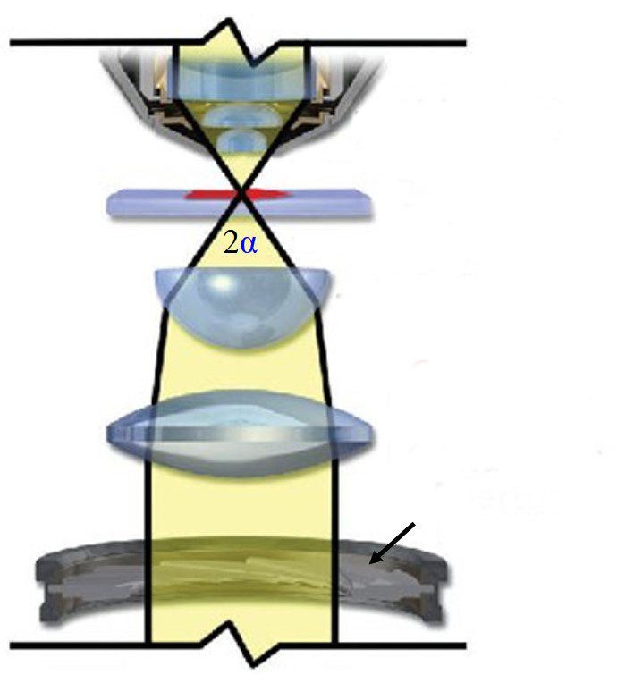
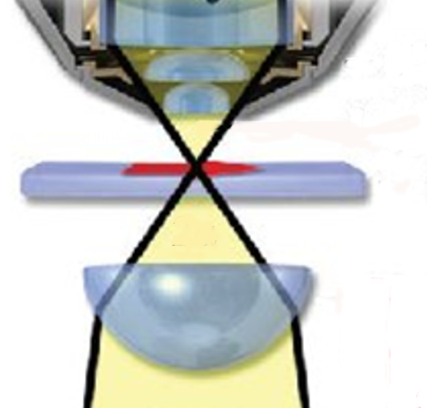
Properties of the Condenser
He produces a cone of light focused oh the specimen
It’s characterized by the Numerical Aperture (NA), an adimensional number that indicate the maximum angle of the light cone focused on specimen
λ
NA = ------------
n * sinα
λ = wavelenght
n = medium refraction index (air in this case…)
α = half cone angle
objective
specimen
condenser
Light cone
condenser diaphragm
(Aperture Diaphragm)
Light cone

Slide 22
Also the objective has a NA
It’s very important to couple correctly the condenser NA with the objective NA:
NA of the condenser must be > or equal (≥)
to that of the objective !!!
(Light cones must be compatible…)

Slide 23
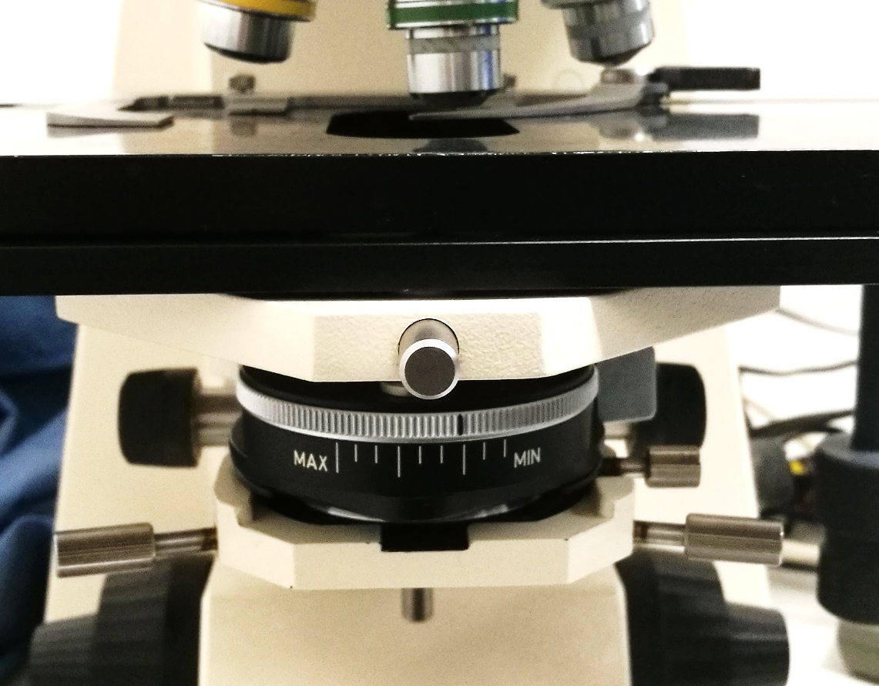
The CONDENSER must be:
Moved up and down
Centered on the optic axis
with the appropriate screws

Slide 24
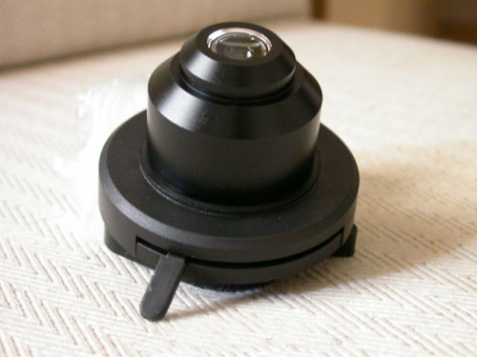
The Condenser has a diaphragm (Aperture Diaphragm) that can be (must be !!) opened or closed with a lever

Slide 25
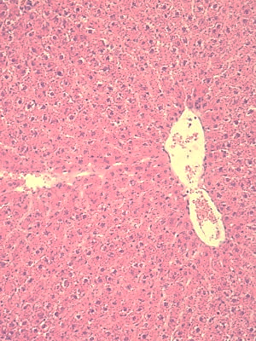
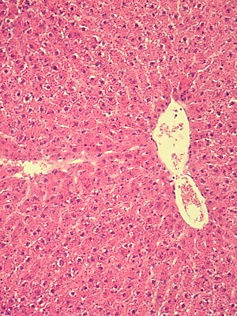
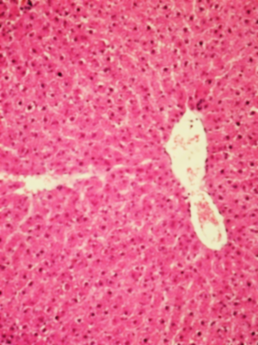
The Diaphragm of the condenser regulates
Resolution and Contrast
of image !!!!
RESOLUTION vs. CONTRAST
Diaphragm opened Diaphragm closed
High resolution High contrast
Low contrast Correct Low resolution
>> Inverse correspondence <<

Slide 26
BE CAREFUL: the human eye is more sensitive to variation of contrast…
A well contrasted image is often confused with a high resolution image…!!!
→ We need to find a compromise between resolution and contrast

Slide 27
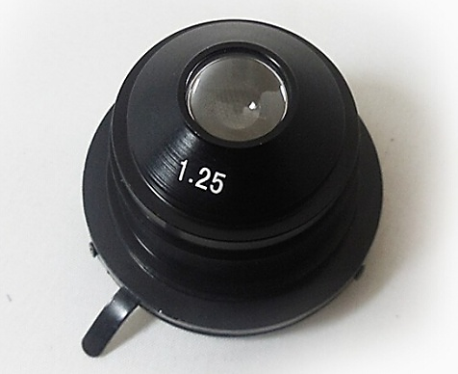
The Condenser
IS YOUR FRIEND !!! USE it’s diaphragm !!!
At Minimum aperture (closed) gives you:
- Thick depth of focus (easy to find cells…)
- High contrast
- Poorer resolution
- Less light ⁽*⁾
At Maximum aperture (opened) gives you:
- Thin depth of focus
- Lower contrast
- Higher resolution (better viewed by the camera…, not by the eye !!!)
- More light ⁽*⁾
Numerical Aperture
Diaphragm lever

Slide 28
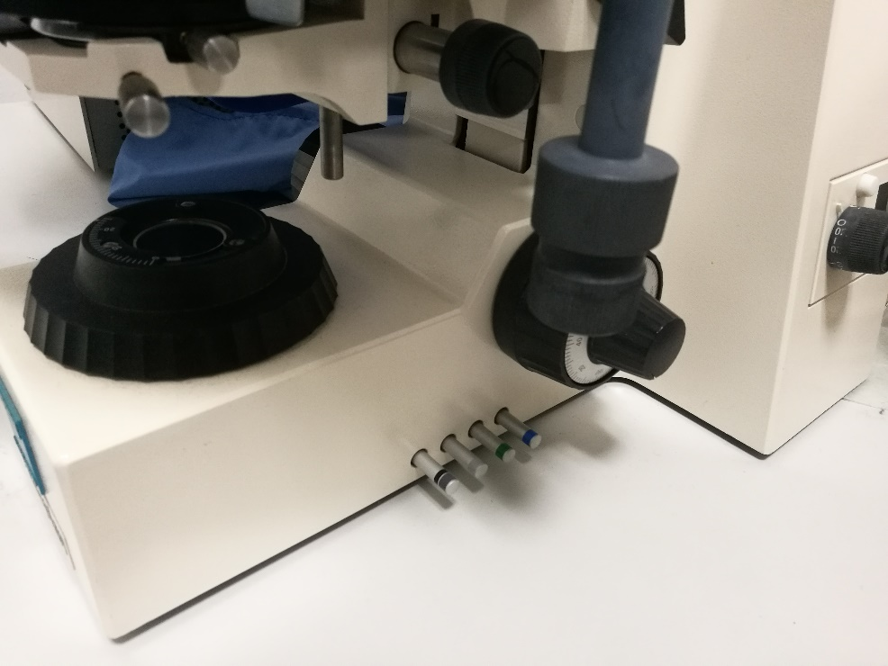
(*) NEVER USE CONDENSER DIAPHRAGM
(Aperture Diaphragm)
TO ENHANCE OR DIMINISH THE LIGHT !!!!!!!
use N.D. (neutral density) grey filters
placed at Field Diaphragm level

Slide 29
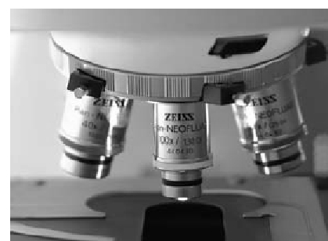
- NOSEPIECE
It is an eccentric rotating body (“revolver") with several threaded holes in which you can enter the objectives. It lets you quickly change objective with a simple rotation of the eccentric

Slide 30
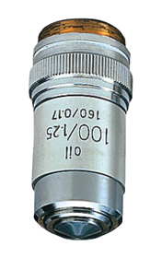
OBJECTIVE
Optical system of short focal length, large angle of light cone collection (NA: 0.15 → 1.4)
It forms an image, enlarged and inverted of the observed object.
It consists of more lenses, opportunely combined to correct aberrations.

Slide 31
The objectives operating in normal environmental conditions (in air) are called "dry objectives".
To increase the angle of light collection we have "immersion objectives’’, to be used with a coupling fluid (oil, water or glycerin) between specimen and objective.
DRY (air) OIL
Air
Oil
specimen

Slide 32
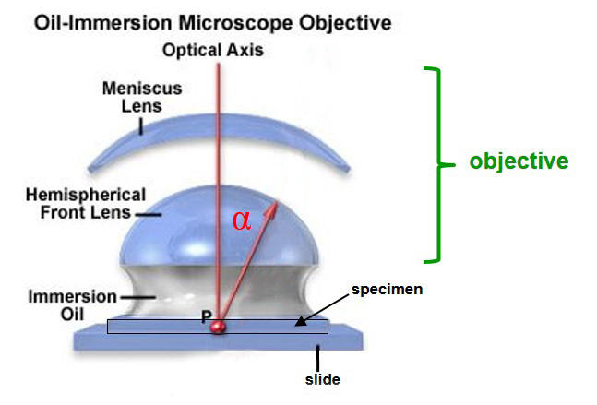
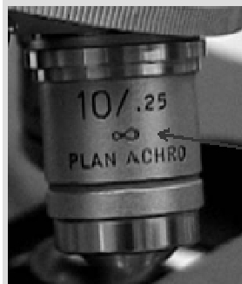
OBJECTIVE
objective
Characterized by its “Numerical Aperture” (NA),
expression of the ability to collect wide light cones
NA = n * sin α
n_{air} = 1
n_{oil} = 1,5
n = Refraction index, where

Slide 33
NA depends also on
refraction index of some medium
Air n = 1
Distilled H₂O n = 1.334
Glycerol n = 1.450
Cedar oil n = 1.515
Syntetic immersion oil n = 1.518
Every kind of objective must be used with appropriate medium between specimen and frontal lens

Slide 34
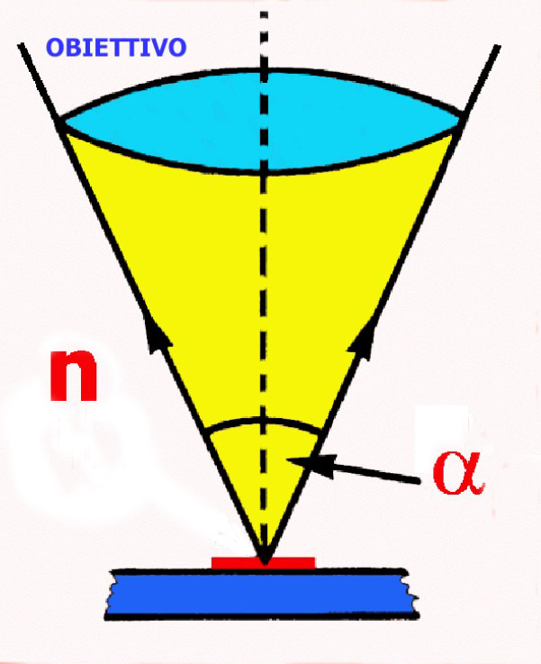
Objective Numerical Aperture
NA = n * sin α
objective
n = refraction index of medium between specimen and objective (here is air)
α = angle between the optical axis and the more lateral raylight that can be captured by the objective
n
air

Slide 35
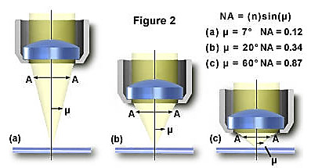
What’s the better objective?
That with higher NA
(Wider cone of light)

Slide 36
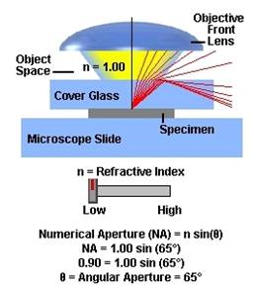
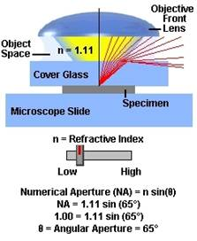
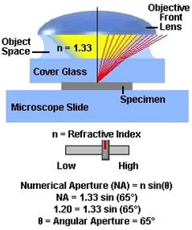
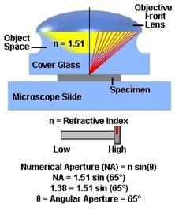
Interactive tutorial
http://olympus.magnet.fsu.edu/index.html
AIR
WATER
OIL

Slide 37
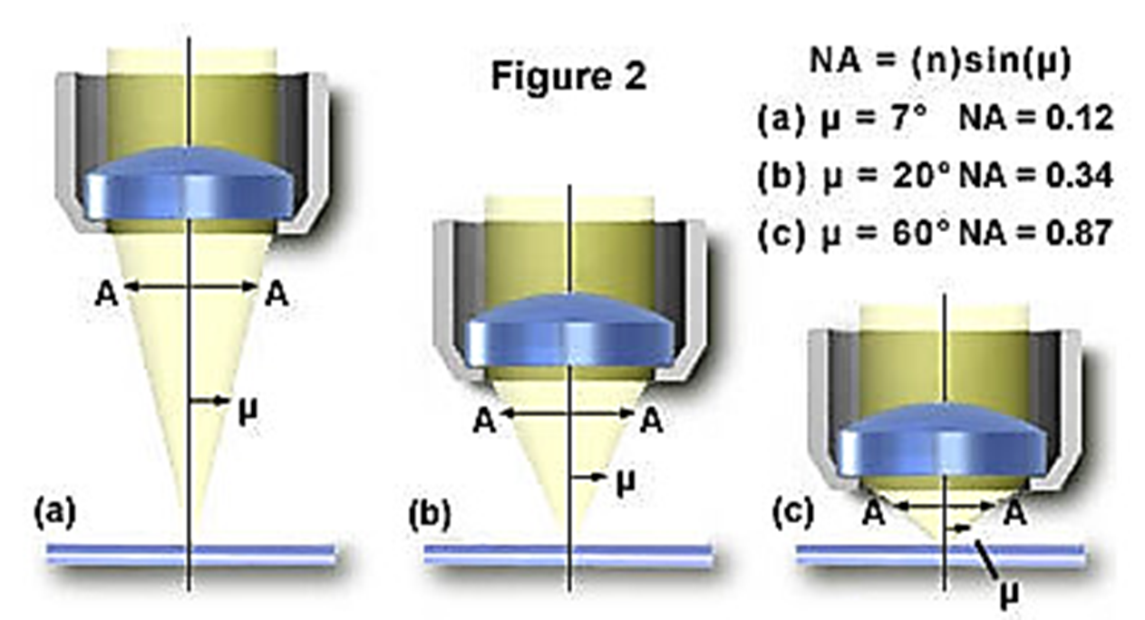
Objective
The larger NA, the higher the quality (and cost…)
(but increase the optical aberrations… → we need correction for…)
The larger NA, the smaller the working distance
There are, however, specifically projected objectives with large NA and higher
working distance (useful e.g. to observe cultured cells in flasks)
→→ INVERTED MICROSCOPES

Slide 38
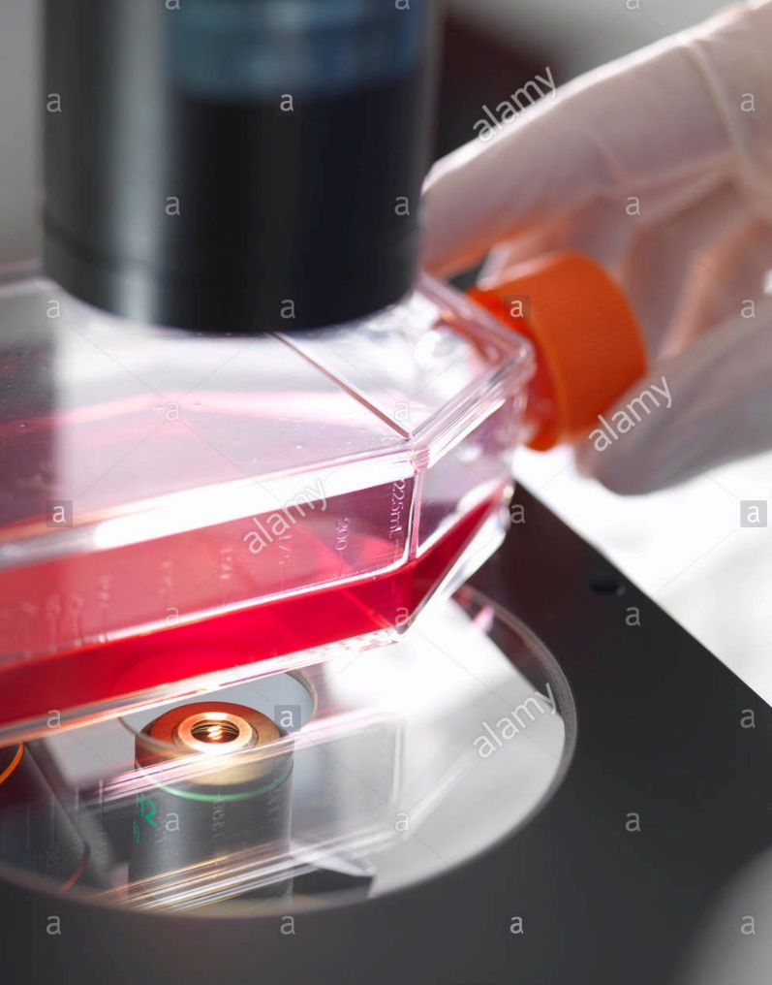
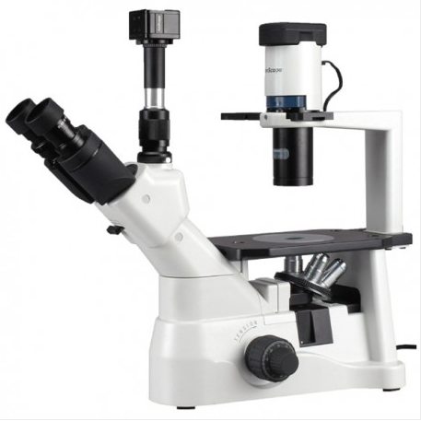
Inverted microscope
Objectives with higher working distance

Slide 39
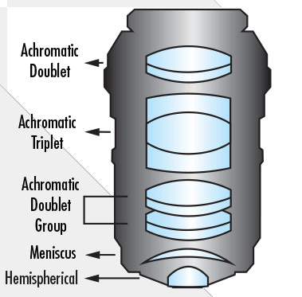
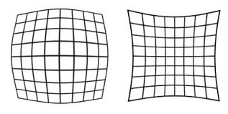
Objective Lens Aberrations
Is an arrangement of different lenses
that interacts each other
Chromatic
Spherical
Coma
Astigmatism
Field Curvature
Distortion (barrel or pincushion)
Every objective is corrected for most of those defects

Slide 40
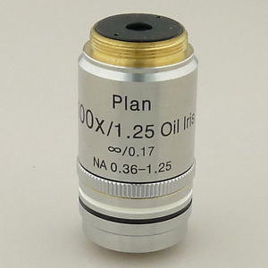
Inscriptions on objectives
They describe the capabilities, limitations and operating instructions for any particular purpose.
There is no absolute uniformity among the brands, but in general, every objective always shows the same information
For example, the lens in figure shows:
Plan 100x/1,25 Oil Iris ∞ / 0,17 NA 0.36-1.25

Slide 41
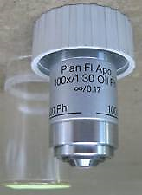
Plan FL Apo
100x/1.30 Oil Ph
∞ / 0,17
Means:
Planar
For Fluorescence
Apochromatic
100x Magnification
1.30 Numerical Aperture
Oil needed between specimen and objective
Phase contrast
Infinity Optics
0.17 coverslip thickness

Slide 42
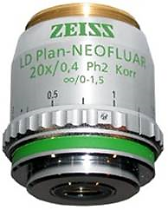
LD Long Distance Plan-NEOFLUAR 20x 0,4 Ph2 Korr ∞/0-1,5
means:
Long working distance (inverted microscope for cell cultures..)
Planar
Fluorescence
20x Magnification
0.4 NA
Phase contrast
Korrection for coverslip thickness
Adjustment for thickness of coverslip between 0 and 1.5 mm
Infinity optics

Slide 43
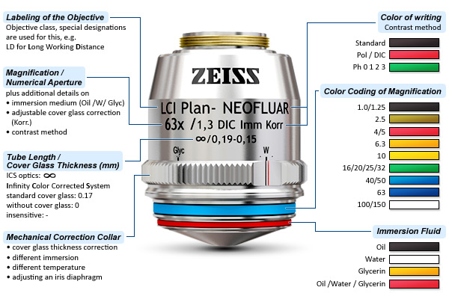
LCI = Live Cell Imaging
Korr = coverslip correction ring

Slide 44
CLEANING objectives
Detergents
· Alcohol 70°: ideal for daily cleaning of the objectives
Petroleum solvent (avio): it’s a good solvent for the immersion oil .
Use occasionally, ONLY in case of heavy encrustations (quickly volatile, flammable
and potentially toxic by inhalation or prolonged contact)
Procedure for cleaning the lenses:
Gently remove excess of oil surplus on the lens with a piece of optics paper (which does not leave debris)
Moisten another piece of paper with the solvent for the oil and clean the front lens with one-directional repeated passages, always using different portions of the paper.
Dry the front lens with optical paper, then clean with compressed air to be sure not to leave residual traces of oil, solvent or dust

Slide 45
Care of Objectives
1 - Gentle! Gentle! Gentle! Gentle! Gentle!
2 - SLOWLY, when rotating objective nosepiece
3 - When changing slides: focus away & remove slide gently
4 - When unscrewing objectives: use 2 hands, don’t let drop, store in a case
5 - CLEANING: -- only sometimes with dry specimens and dry lenses
-- USE ONLY SPECIAL LENS PAPER with 70° ethanol
-- NEVER USE Kleenex, toilet paper etc.
-- GENTLE blot frontal lens, with monodirectional
movements, changing zone of wet paper

Slide 46

Eyepiece

Slide 47



Eyepiece
Camera
Giovanni Battista Amici (Modena, 25 marzo 1786 - Firenze, 10 aprile 1863)
Deviation Prism (or Amici’s prism)
It’s a prism that splits the optical axis of the microscope, one path to the eyepiece (in a more comfortable way for the observer), the second to a camera

Slide 48



Eyepiece for microscopy
It’s the lens system that permits to the eyes to observe the image formed by objective
- It’s interchangeable
- It provides a further magnification of image.
The TOTAL MAGNIFICATION of the microscope is the product of the
magnification of the objective and the eyepiece.
In modern microscopes, the eyepiece produces a parallel beam of light that encounter the eye pupil. The diameter of this beam is called "exit pupil”, and correspond ± to the diameter of human pupil, so that the retina can observe the entire visual field of the instrument.
MA = M_{obj} x M_{eyep}

Slide 49


Optical scheme of the a modern eyepiece (after 1980…)
Parallel beams
microscope
eyepiece

Slide 50
HOW IMAGES ARE FORMED
https://micro.magnet.fsu.edu/primer/anatomy/image.html

Slide 51
Rays of light coming from the light source are focused on the sample by means of a condenser
After passing through the sample, the rays form a magnified image by means of the system of lenses objective+ocular (eyepiece)

Slide 52
The optical microscope is an arrangement of lenses.
further

Slide 53
2 optical systems are present in the microscope:
■ Objective: High power convergent lens
- it provides an intermediate real image of the object,
which is formed in a plan inside the instrument
■ Ocular (eyepiece):
- it sees the intermediate real image of the object
and shows us a virtual image further enlarged

Slide 54
Objectives are classified in terms of NA, which measure the ability to capture the highest number of diffracted rays from the sample.
The higher the number of diffracted rays, and the greater the angle with which they are diffracted, the greater is the resolution obtained
Those diffracted rays allow us to distinguish the finest structural details of specimen.

Slide 55
The wider is the light cone
=
The higher the NA (condenser & objective)
=
The higher the number of raylight that hit the specimen and the angle with wich they are diffracted
=
The higher the resolution of formed image

Slide 56
Light can be described in terms not only of particles (photons), but also of waves.

Slide 57

What is the Diffraction
It’s a physical phenomenon associated to the wave propagation
It’s typycal of all waves (sound, radio and light)
It happens everytime a wave encounters an aperture or an obstacle of a similar size to its own waveleght

Slide 58
Waves can be diffracted…
Waves can interfere each other…
The interference can be positive or negative:
- If positive produces light (constructive interference)
- If negative produces dark (destructive interference)

Slide 59

Order of interference
POINT
0,1,2,3
= LIGHT
Intervals between POINT 0,1,2,3
= DARK

Slide 60

Diffraction
Interference
Order of interference
Double
slit
Double slit
Light band
Dark band
Light band
Dark band
Light band
Dark band
Light band
Dark band
Light band
2
1
0
1
2
Single slit
Light source
Constructive interference → Light
Destructive interference → Dark

Slide 61
THEORY OF IMAGE FORMATION
by Ernst ABBE

Slide 62
This theory affirms that the structure of the sample produces diffraction of light in the Back Focal Plane (BFP) of the objective.
However, this only happens when the light passes through a dishomogeneous sample, because the inner irregularities diffract the raylights.
If the sample in homogeneous the light in not diffracted.
E.g. Cells have nucleus, cytoplasm, organelles, Golgi, RER, granules, proteins…
→ HIGHLY DISHOMOGENEOUS

Slide 63

Specimen Objective Focus Real
(BFP) Image
Object Focus Image
BFP
Light
Dishomogenous
sample with microscopic irregularities
Diffraction figure deriving from microscopic irregularities
of the sample
NORMALLY NOT VISIBLE, BECAUSE INSIDE OF THE MICROSCOPE
Image of the sample reconstructed from the interference between the direct raylights and the diffracted raylights

Slide 64

THEORY OF IMAGE FORMATION
by Ernst ABBE

Slide 65
Abbe theory of Image formation
Image is formed by collecting with the objective the raylights that pass through the specimen and that are diffracted by the inner dishomogeneities.
Direct and diffracted light interferes in the BFP of the objective, then are projected in the front focal plane of the ocular, hence to the eyes.

Slide 66



Abbe demonstrated his theory with several experiences with conoscopic images, obtained in the objective BFP (Back Focal Plane) and originated by special simplified samples represented by ’’gratings’’ (lines or dotted reticuli)
Simplified
specimens
respect to →→→→

Slide 67

Grating =
lines reticulum
https://www.olympus-lifescience.com/en/microscope-resource/primer/java/imageformation/gratingdiffraction/

Slide 68

Grating =
points reticulum

Slide 69

Specimen Objective Focus Real
(BFP) Image
Object Focus Image
BFP
Light
Dishomogenous
sample with microscopic irregularities
Diffraction figure deriving from microscopic irregularities
of the sample
Image of the sample reconstructed from the interference between the direct raylights and the diffracted raylights
Diffracted raylights
Direct,
non diffracted, raylights

Slide 70
Abbe formula for Resolution "d“
(the minimum distance at which 2 point appear distinct and not confuse)
’’d’’ is function of the Numerical Aperture NA of the objective
λ λ 0,612*λ
d = -------------- = ---------- = --------
2n * sinα 2 * NA_{obj} NA
but: n * sinα = NA_{obj}
NB: ‘’α’’ is HALF cone angle,
n = refractive index of the medium’’ ’’
Rayleigh
modified formula

Slide 71
Optimal resolution with Abbe theory
USING an Objective lens with a large NA
(+ cleaver use of diaphragms and lighting) in order to collect light with the maximum possible angles of diffraction

Slide 72

Only objective determines the resolution ?
NO condenser: absence of oblique rays that are necessary to have resolution
YES: illumination
cone with equal
aperture of the
collecting cone
Illumination cone:
Too small → low resolution
Too big: → low contrast
NO, also the condenser affects the resolution (and contrast) !!

Slide 73

PRACTICAL WORK:
To FIND a compromise between contrast and resolution
If you close the condenser diaphragm (Aperture Diaphragm) contrast increases and resolution decreases, and vice-versa

Slide 74
Resolution
The minimum distance at which two points are seen as distinct is called Resolution or Resolving Power. For the compound light microscope the value of the Resolution is defined by "Abbe formula“
λ λ 0.612 * λ
Resolution d = ------------ = ----------- = -----------
2n * sinα 2 NA NA
where: 0.61 = constant
α = half-angle under the objective lens
λ = wavelenght of used light (400-700 nm)
n = refraction index of the medium between objective and specimen
n * sinα = NA
Abbe
Rayleigh
HOW TO IMPROVE the resolving power of microscope:
  diminishing λ (using UV light…) but dangerous for eyes !!
  increasing α (but with more aberrations….)
  3. increasing n (using oil immersion objectives….)

Slide 75

Dry and immersion objectives
Oil between specimen and objective permits to collect information from a wider angle of light (more interference = more details)
wider angle

Slide 76



DRY and IMMERSION objectives
Refractive index
Dry (air) = 1
Water = 1.33
Glycerol = 1.47
Immersion oil = 1.518
Snell’s law of refraction
n₁ * sin(o₁) = n₂ * sin(o₂)
n = refractive index
AIR
BAD
OIL
GOOD

Slide 77

Coverslips
For oil objectives, the coverslip is really a lens element.
Some objective has a graduated ring to adjust the thicknes of the coverslip employed
USE Coverslip n°1.5 (Thickness (0.17 mm), especially with 63x Oil and 100x Oil obj.
If not you can have difficulties to focus the specimen !!

Slide 78
ILLUMINATION
of specimen

Slide 79

August Köhler (1866-1948)
In 1893 he invented a method of providing optimum illumination of specimen while working at Zeiss Corporation.
This made photomicrograpy possible.

Slide 80
Before Köhler
The image of tungsten lamp filament was in focus with the specimen
It was impossible to take good photographs of specimens

Slide 81

LAMP
SPECIMEN
Eye
BEFORE Köhler

Slide 82
The illumination in optical microscopy
A good illumination, strong and homogeneous, is essential not only to take photographs, but also to apply several contrast techniques, such as Phase Contrast or DIC (Differential Interference Contrast)
To perform those techniques more optical elements should be inserted in the path of the light rays, which absorb most of the luminous flux.
Notes:
82

Slide 83

Köhler lighting
It’s the most widely used method.
It produces the highest intensity of light from non-homogeneous sources (lamp filament).
The illumination of specimen will be uniform and free from glow.
The principles of Köhler lighting applied to modern microscopy can be summarized to:
A - focusing the filament image in the diaphragm plane of the condenser (Aperture Diaphragm) using the collector.
B - focusing the image of the field diaphragm in the specimen plane using the condenser.
In this way the light source is not focused on the specimen level, the lighting will be extended and without grain, and will not suffer from the imperfections of the condenser glass surfaces (dust).
specimen
specimen
specimen
A
B
Parallel rays
Illuminating light paths
Imaging light paths

Slide 84

Köhler lighting procedure
Chose objective and put the specimen on focus
Close to 2/3 the field diaphragm, visualizing them in the visual field
Raise and lower the condenser until the image of the field diaphragm (a poligonal figure…) is on focus with the specimen
Center the polygonal image (the condenser indeed) respect to the visual field (with the aid of the central cross) using the screws under the stage. The image of the field diaphragm will be centered
Verify that both specimen and image of field diaphragm are simultaneously on focus and centered
RE-OPEN the field diafragm ONLY UNTIL ITS IMAGE DISAPPEAR from the visual field (in order to prevent straylights).
Remind !!! Repeat the procedure each time you change objective !! (it takes only 15 seconds…!)

Slide 85
SPECIAL MICROSCOPICAL TECHNIQUES

Slide 86
WEB Interactive TUTORIAL
Zeiss: http://zeiss-campus.magnet.fsu.edu/tutorials/index.html
Olympus: http://www.olympusmicro.com
Nikon: http://www.microscopyu.com

Slide 87
You can use Optical Microscopes for different applications:
Brightfield Microscopy
Darkfield Microscopy
Phase Contrast Microscopy
DifferentialInterference Contrast Microscopy (DIC)
Polarized Light Microscopy
Fluorescence Microscopy.
Confocal Microscopy
……
Only with NEW microscope ’’corrected to infinity’’

Slide 88

OLD microscopes
architectures were based
on the “tube of finite length
(= 160mm)”
In NEW microscopes the
scheme was modificated
introducing special objectives
and a ’’TUBE LENS’’, with
parallel raylights in between.
This is a “correct to
Infinity” scheme. In this space
we can insert additional
optical elements to improve
quality of the image.
Tube lenght 160mm

Slide 89
Bright Field, BF
It’s the “common“ technique: the objective collects all the light that is transmitted or diffracted by the sample.
It’s based on the greater or lesser absorption of light (or some wavelengths) from different areas of the sample, which are more or less bright (or of different color).

Slide 90
Phase Contrast
Microscopy

Slide 91

Frederik ’’Frits’’ Zernike
(Amsterdam 1888 - 1966) invented Phase Contrast microscopy to study unstained cells in 1933.
He got the Nobel Prize in 1953

Slide 92
Unstained living cell in culture are very transparent objects.
When observed with a bright-field microscope they produces images with very poor contrast, which makes very difficult or impossible recognize and distinguish delicate details of specimen.
This is because light absorption of such objects is too low to provide sufficient amplitude changes of the transmitted light (producing bright-dark contrast).
However nucleus, cytoplasm, organelles have small density differences, or different refractive index, that modifies the optical path of light.
Every structure introduces different shift between light waves, that procede with different delay, with different phases.

Slide 93
Retarded raylight
from the specimen
Unaffected raylight
specimen
Glass slide
2 rays with different phases

Slide 94
Unfortunately human eyes are unable to detect these phase differences. They can only see variation of frequency (e.g. different colors) or amplitude (intensity of colors – lighter or darker)
The phase contrast technique is intended to convert such phase shifts into amplitude differences that are detectable by the human eye (→ producing a bright-dark contrast).

Slide 95
Two special optical elements (Phase Rings) are introduced in the ’’infinity space’’
Inside the condenser and inside the objective…

Slide 96
Phase ring
(inside the objective,
signed Ph)
The 2 rings are complementary
Light ring
The background light is colored orange and the object light is rose

Slide 97
POINT
0,1,2,3
= LIGHT
Intervals between POINT 0,1,2,3
= DARK

Slide 98
The phase shift between transparent objects ad dense object in the specimen is about ¼ λ
The interfererence between retarded rays that hit the dense portions of the specimen and undeviated rays hitting transparent ones is destructive, so object appears dark on a brighter background, BUT WELL VISIBLE !!!
Starting at a certain thickness, phase contrast objects show light or dark "halos" along their edges and simulate a kind of 3D effect.
This is due to the fact that a small part of the diffracted object light passes through the phase ring as well and interferes at the image plane. Thus, these halos may not necessarily represent the actual structure of the sample.
It’s an artifact !!!

Slide 99
The 2 Phase Rings in the condenser and in the objective ENHANCES the small differences of phase, converting it in amplitude differences that human eye can appreciate

Slide 100


PHASE CONTRAST
Easy to set up
It works through plastic → useful for cell culture in flasks
It has low resolution

Slide 101

Objectives have green lettering
and “Ph” indication

Slide 102


Slide 103





Slide 104


Slide 105





Slide 106
Differential
Interferential
Contrast
(DIC or Nomarski)

Slide 107

Jerzy Nomarski
(Nowy Targ, Poland 1919 - Paris 1997) developed the Differential Interference Contrast microscopy technique

Slide 108
The interferential microscope is based on a ’’infinity corrected’’ microscope, with addition of 2 optical accessories:
one under the condenser
a second above the objective.
Each optical group consists of a polarizing filter + a Nomarski prism (then modified by Wollaston).

Slide 109


The polarizer:
The prism is designed as a pair of wedge-shaped birefringent prisms of quarz with equal dihedral angle, glued together with the optical axes crossed.

Slide 110
The prism generates two beams polarized on perpendicular planes that hit separately the specimen, both bringing information of the specimen.
Both rays are diffracted by the specimen, then enter the objective separately, bringing different informations.
They interfere and produce two images
The 2nd prism combines the two rays, and the 2nd polarizer swings the two rays on the same plane
The result is a pseudo-3D image of the specimen

Slide 111

Nomarski / Wollaston Prism
Nomarski / Wollaston Prism

Slide 112


Differential Interference Contrast (DIC)

Slide 113

Brightfield
DIC

Slide 114

… ooops…!!!!
DIC
Brightfield
Is the cell a concave or a convex object? Often it’s a subjective impression…

Slide 115

Steatotic Liver, DPP-IV enzyme activity at bile canaliculi level
Arrows = lipid droplets

Slide 116

The same picture, simply rotated of 180 degrees…

Slide 117



HeLa cells
Fertilized eggs
Amoeba

Slide 118

C. elegans + GFP

Slide 119

…most images found on the internet….
BAD or NO Köhler illumination …!!!
…….ahiahiahiahi ………!!!!!

Slide 120


Comparison between the two methods
https://www.microscopyu.com/tutorials/comparison-of-phase-contrast-and-dic-microscopy

Slide 121




Phase Contrast

Slide 122
PHASE CONTRAST
Pros:
Cheap
Simple
Cons:
Poor resolution
Halo around object
DIC
Pros:
Higher resolution
No halo
3D effect
Cons:
Expensive
Complicated
Choose one or the other depending on your real needs…

Slide 123
Thank you for your attention !

